Slide 1
CSE-465
Final Presentation
Redwan Rabbi Hoque
ID - 1311482042
Object Detection - Ships

Slide 2
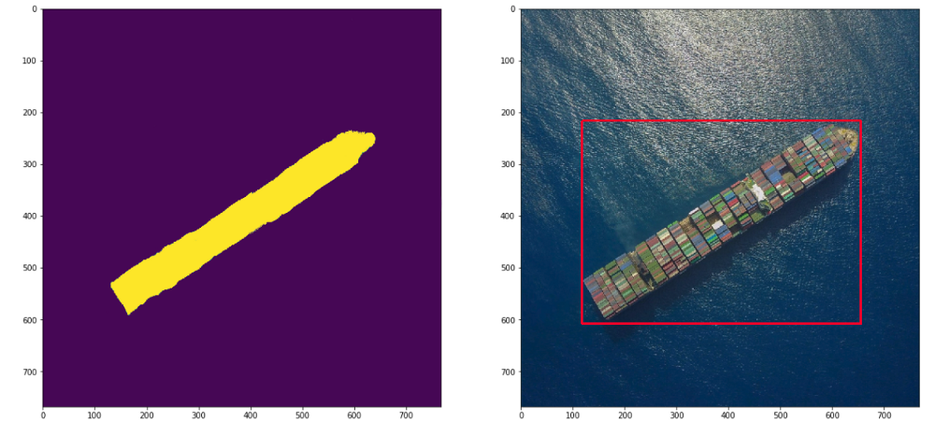
Ship Detection

Slide 3
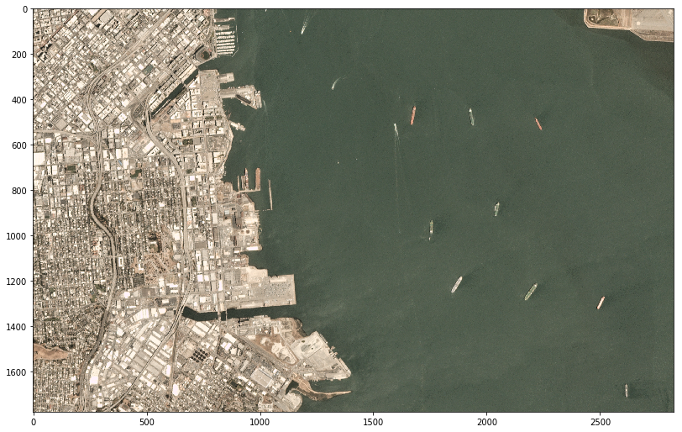
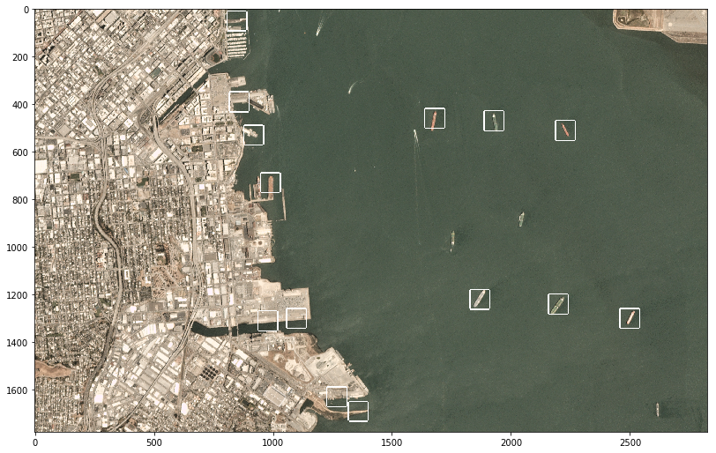
Ship Detection

Slide 4
Dataset Link - https://www.kaggle.com/rhammell/ships-in-satellite-imagery
Github Link - https://github.com/RedwanRabbiHoque/Ship-Detection
Library Link
PIP https://bootstrap.pypa.io/get-pip.py

Slide 5
THANK YOU

